Slide 1
General Practice Nurse (GPN) Leadership Fundamentals Modules
We are excited to launch a series of interactive GPN Leadership Fundamentals Modules, developed exclusively for General Practice Nurses and Nurse Practitioners. The three modules are accessible at no cost to all GPNs via the NHS Leadership Learning Zone (LLZ) and are mapped against the Primary Care and General Practice Nursing Career and Core Capabilities Framework
The modules explore the difference between leadership and management and what it means to be a nurse in a leadership position. Topics include managing change, performance and behaviour, managing conflict, influence, self-care and compassionate leadership:
 | Module overview
Module 1 | This module reflects on what leadership means in a nursing role, illustrating learning points from scenarios. It will offer opportunities to reflect on what you learn and how to apply it to your own experience.
Module 2 | Building on module 1, this module delves deeper into the role of nurse leadership focusing on change, performance, behaviours and conflict.
Module 3 | Building on modules 1 and 2, this module delves deeper into the role of nurse leadership focusing on compassionate leadership, influence, and self-compassion.

Slide 2
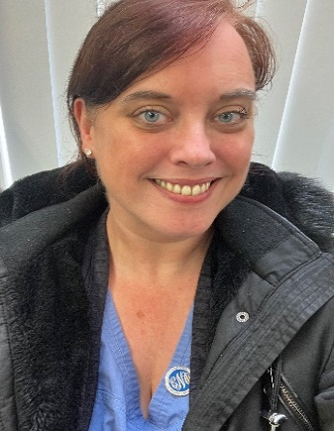
GPN Leadership Fundamentals Modules
‘Am a delighted to have been able to contribute to the development of the online GPN Leadership fundamentals.
Relational care sits at the heart of general practice, from identifying leadership styles to introducing coaching principals, and influencing population health for better care outcomes, these modules will support nurses new to general practice, and those experienced practitioners who want to develop different strategies to support their leadership work and care’.
Louise Brady, Primary Care Nursing Lead, NHS England
How to access the e-learning:
To access the modules please select your region and register for a free Leadership Learning Zone account at https://leadershipnhs.uk/
Once you have created an account and logged in, you will see the modules displayed on the front page.

Slide 3
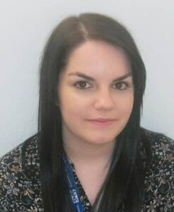
GPN Leadership Fundamentals Modules
Should you have any comments or questions regarding the modules, please contact the North East and Yorkshire System Leadership team:
Sarah Knowles
Head of Leadership (System Transformation)
Sarah.knowles4@nhs.net
Stephanie Wilton
System Development Manager (Interim)
Stephanie.wilton@nhs.net
https://ney.leadershipacademy.nhs.uk/

